Slide 1
Reinforcement
Learning
OpenAI Problems

Slide 2
Team Information
 | SID | Part | Contribution
Denny-Thomas- Varghese | 55506653 | CartPole | 33%
BATYRBEKOV Ilias | 55591554 | Mountain Car | 33%
AGALTSOV Daniyar | 55340231 | Pendulum | 33%

Slide 3
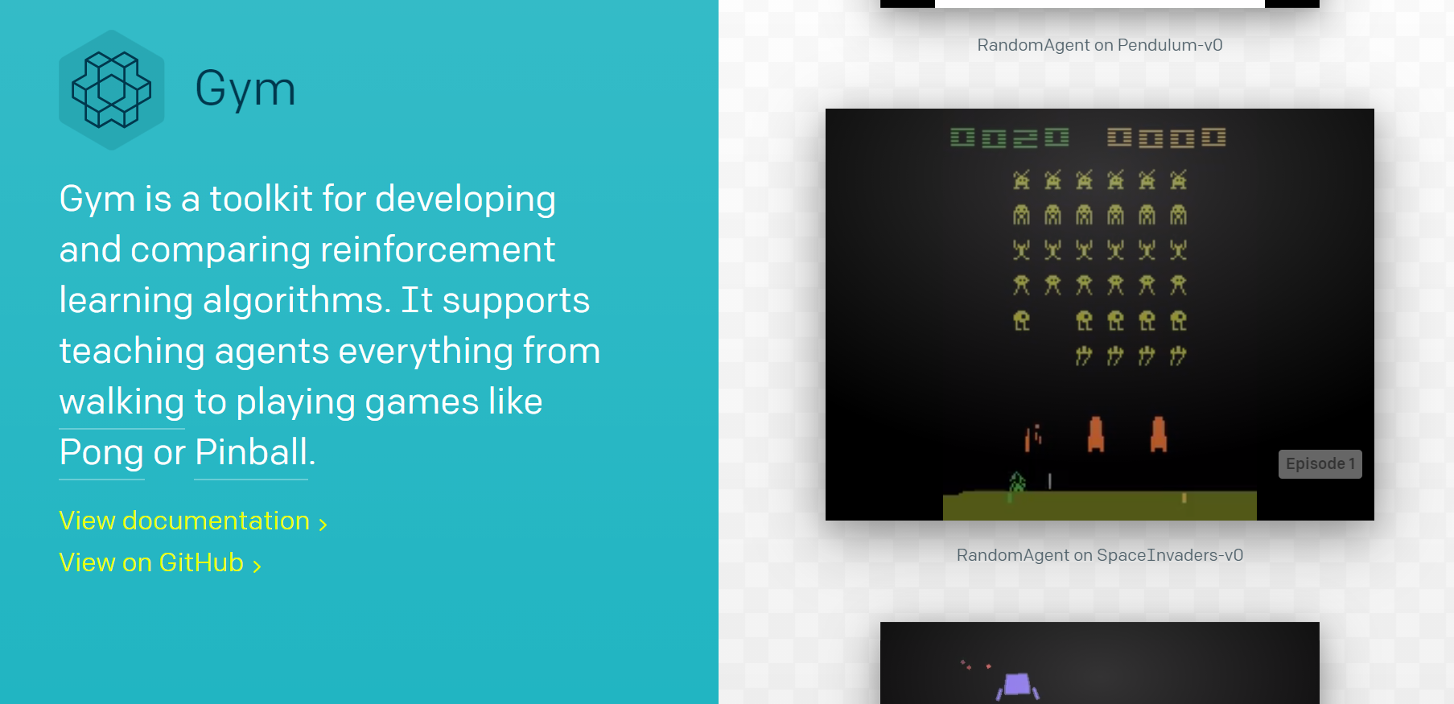
OpenAI Gym

Slide 4
Table of Contents
1
2
3
Mountain Car
CartPole
Pendulum

Slide 5
QLearning
Mountain car

Slide 6
Mountain Car Problem
Objective: reach the flag.
Problem: car is not powerful enough
Solution: learn to gain momentum

Slide 7
Q Learning Procedure
1
2
3
Initiate QTable
Choose Action
Update QTable
Initiate QTable with random values. To have no prior knowledge about environment.
Choose an action from QTable, or a random action with probability of ε .
Stop if flag is reached. Else update QTable and go back to 2.

Slide 8
Hyper parameter tuning

Slide 9
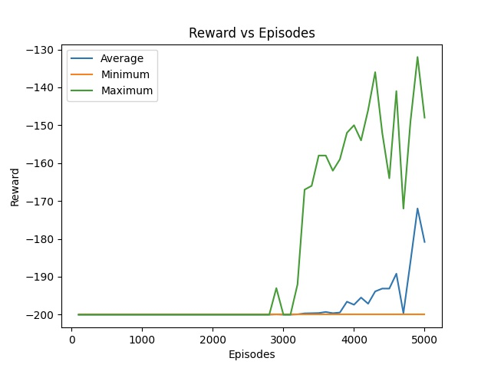
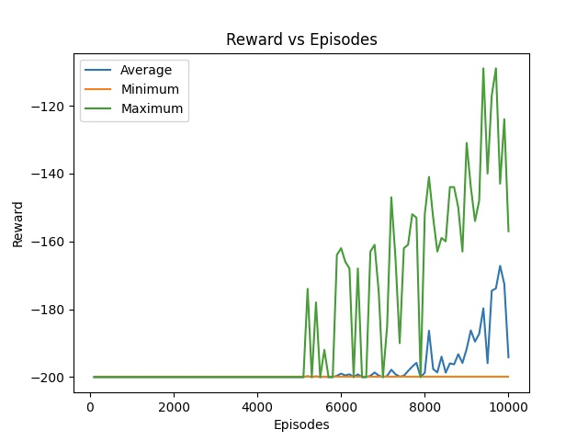
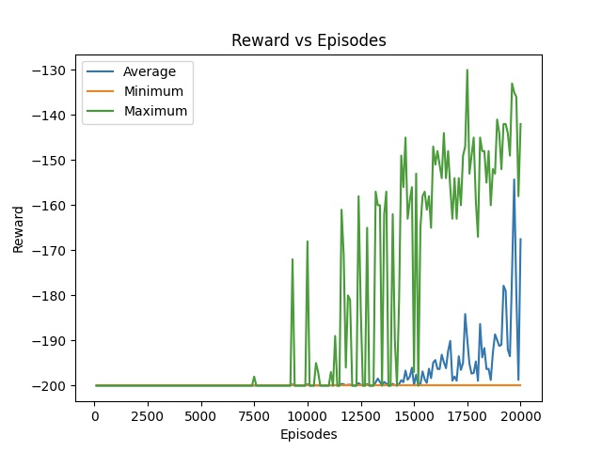
Number of Episodes (t)
5 000
10 000
20 000
No improvement after 15 000

Slide 10
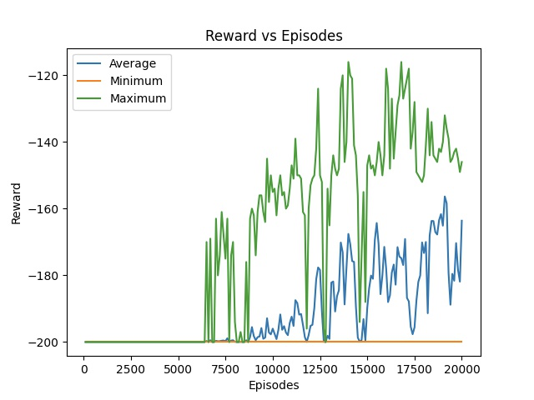
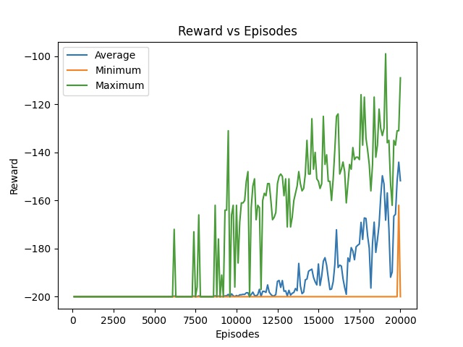
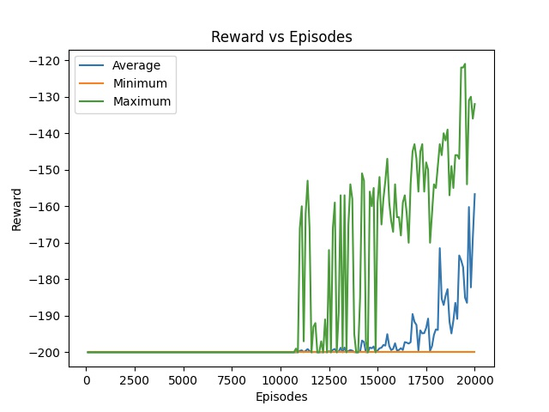
Learning Rate (α)
α = 0.01
α = 0.1
α = 0.2
Highest reward values

Slide 11
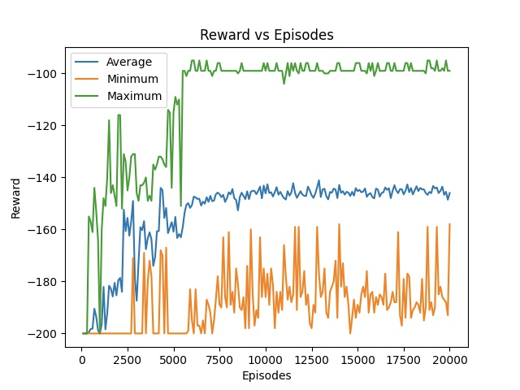
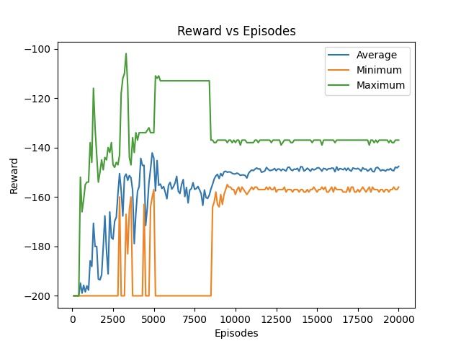
Epsilon (ε) decay methods
ε ->ε_{min} in n_{episodes}
ε = ε /2 each ep.
ε = ε /1.5 each ep.
Highest reward values

Slide 12
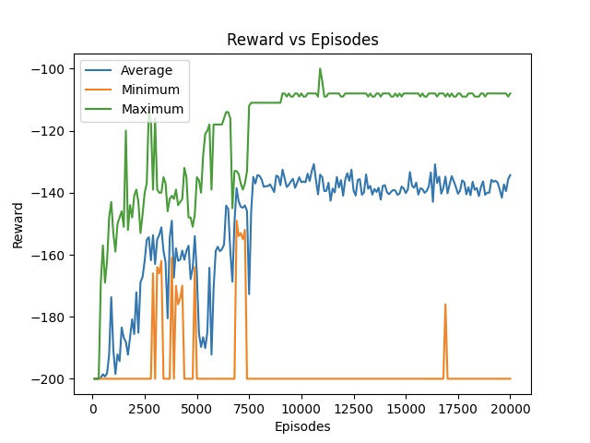
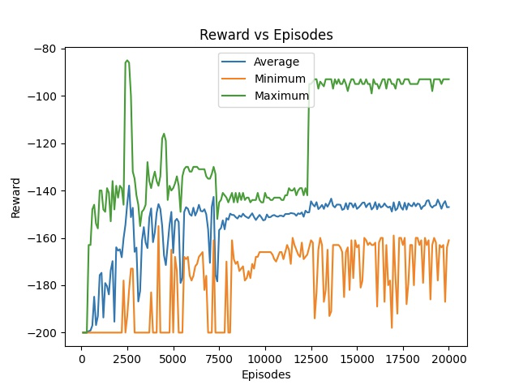
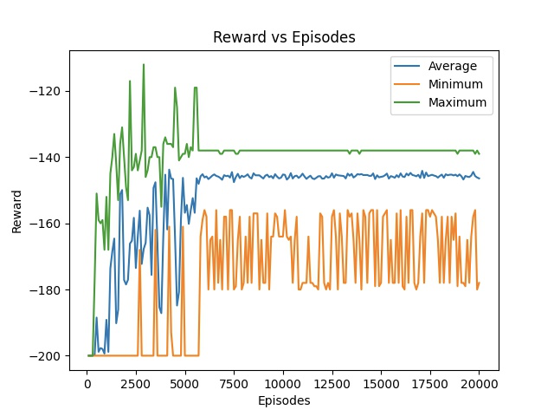
Discount factor ( γ)
γ = 0.85
γ = 0.95
γ = 0.9
γ = 1.0

Slide 13
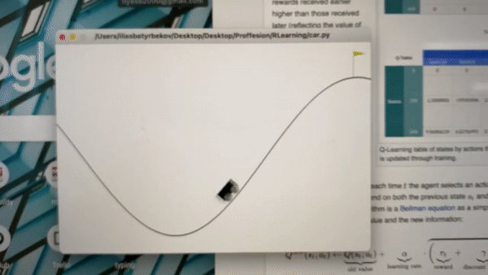
Result:

Slide 14

Deep Q Learning
CartPole

Slide 15
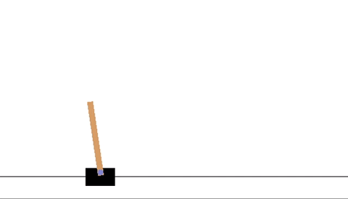
CartPole Problem
Move the Cart Left and Right
Balance the pole for 500 frames

Slide 16
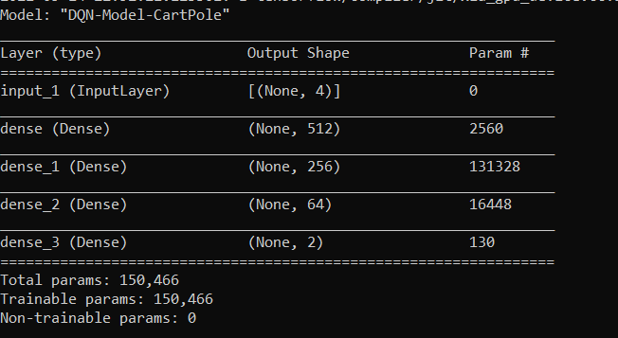
Components of the DQN
1
The Neural Network
Using Keras
3 Hidden Layers with node-counts 512, 256 and 64
MSE Loss Criterion

Slide 17
Components of the DQN
2
3
4
Target or Q Values
The Remember function
The Replay Function
Obtained when the NN model does .predit() on a state
Updated to be: Immediate reward + discounted max found in for all actions for a state
Stores previous observations in memory
Performs selective decays of epsilon for storing cumulative reward later
Uses the previously created memory to re-train the model on previous observations

Slide 18
The Best Results Observed
Hyperparameters Used for the best results:
No of episodes: 1000
Epsilon: 1.0
Epsilon Decay: 0.999
Gamma / Discount Rate: 0.95
Batch Size: 64

Slide 19
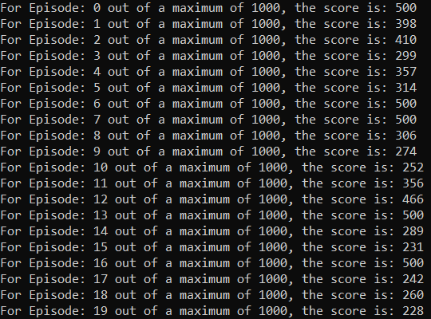
The Best Results Observed
The testModel() function is run and scores are as follows for 20 episodes (maximum score of 500):

Slide 20
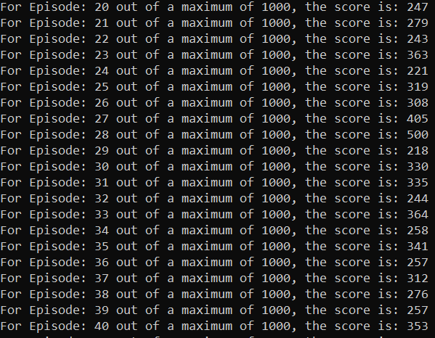
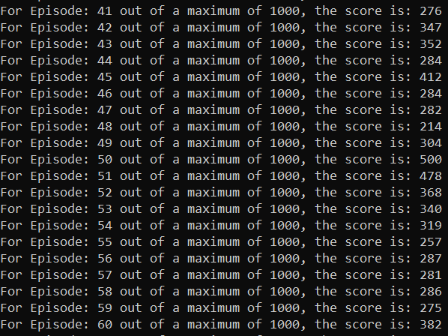
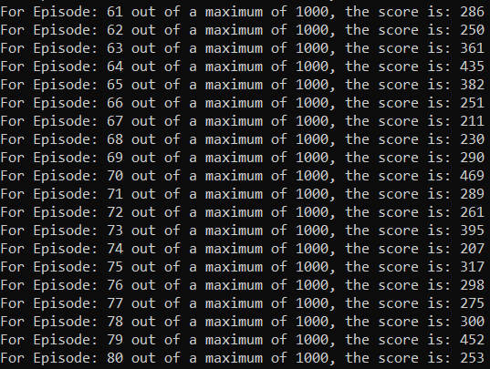
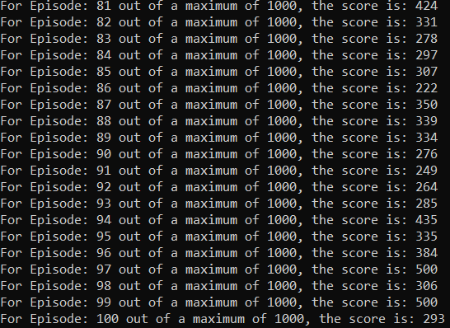
The Best Results Observed for the next 80 test episodes
(Maximum score = 500)

Slide 21
3
DDPG
Pendulum

Slide 22
Pendulum Problem
Apply force and torque
Keep pendulum in an inverted position
Maximum amount of time!

Slide 23
How to Solve?
Continuous actions space
Expensive computing max_{a}Q(s,a)

Slide 24
Solution - DDPG!
Deep Deterministic Policy Gradients algorithm (DDPG)
Concurrently learns Q function and Policy

Slide 25
Deep Deterministic Policy Gradients
1
2
Policy-Gradient Algorithm
Actor-Critic Algorithm
Computes noisy estimates of the gradient of the expected reward of the policy and then updates the policy in a gradient direction
Actor - proposes an action given a state
Critic - predicts if the action is good or bad given a state and action

Slide 26
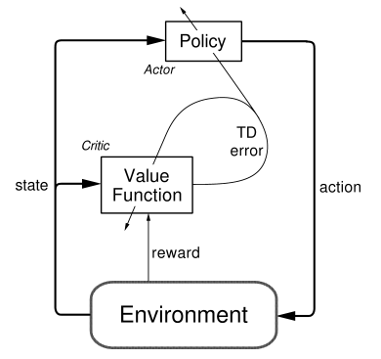
Actor-critic architecture

Slide 27
How is DDPG different from DQN
1
2
Two Target Networks
Experience Replay
Adds stability in training
DDPG learns from estimated targets and target networks are updated slowly
Stores a list of tuples(state,action, reward, next_state)
Instead of learning only from the recent experience, it learns from all experiences

Slide 28
How is DDPG different from DQN
3
Noise Generation
Better exploration by the Actor network
Ornstein-Uhlenbeck process for generating noise
Samples noise from a correlated normal distribution

Slide 29
Hyper parameter tuning

Slide 30
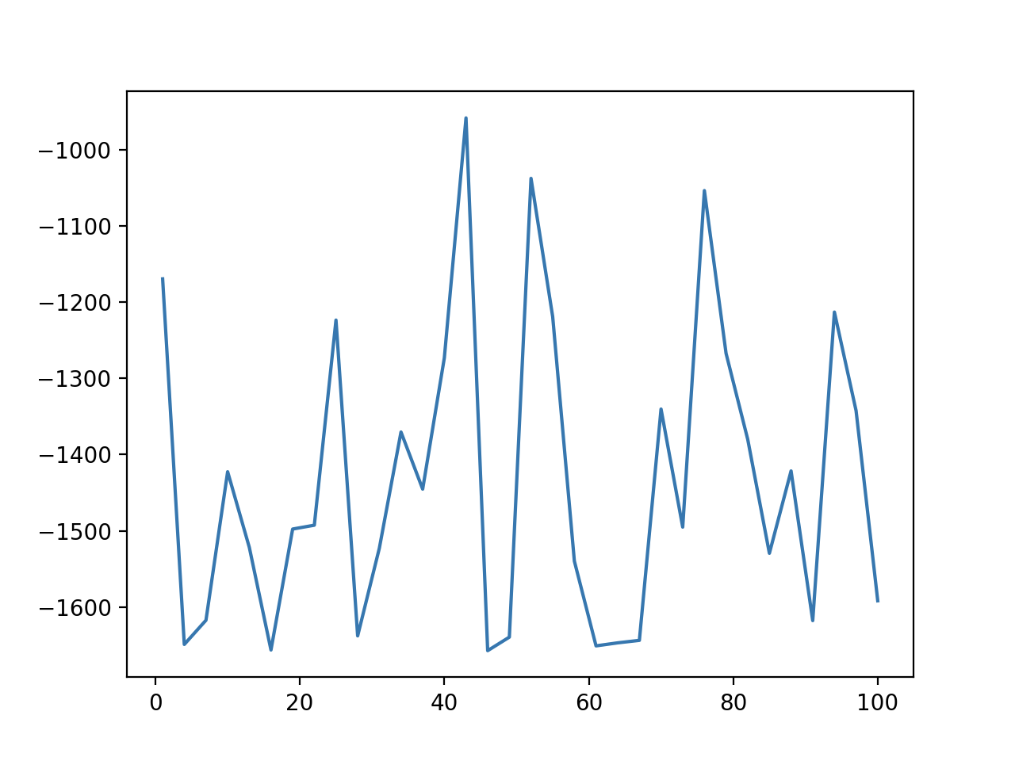
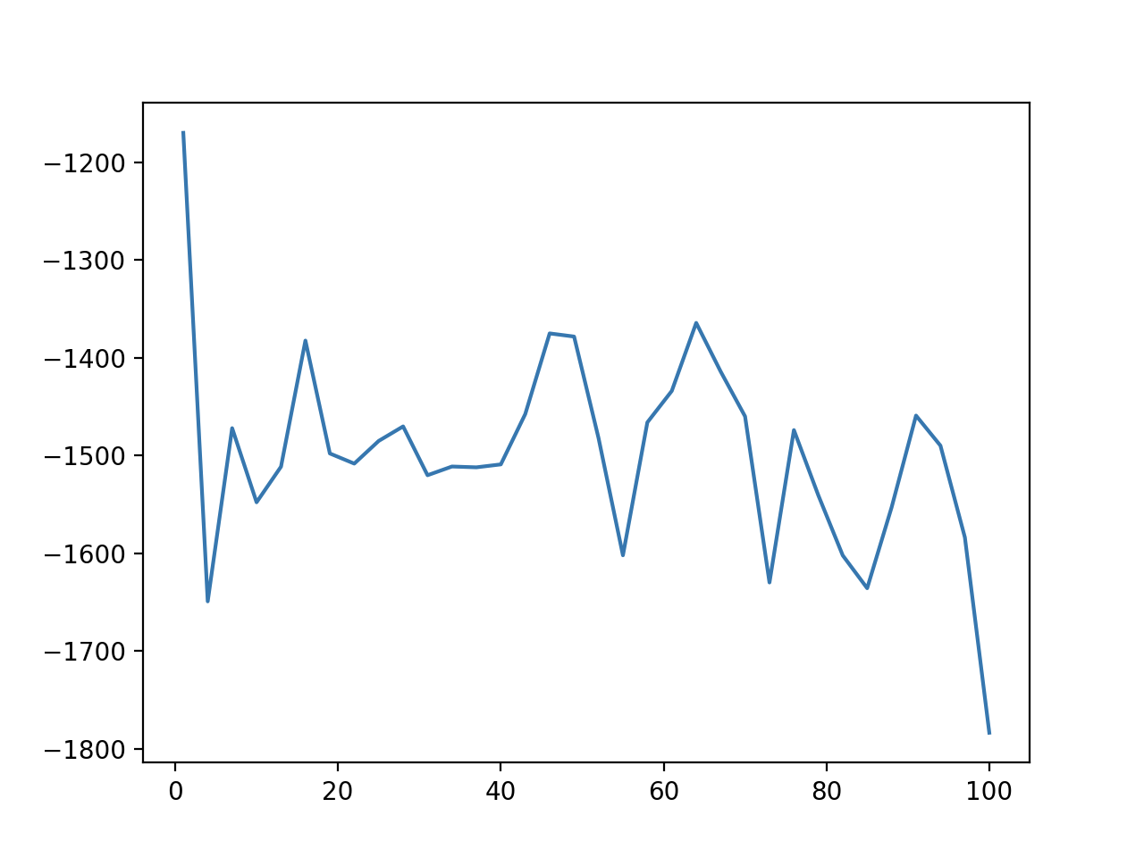
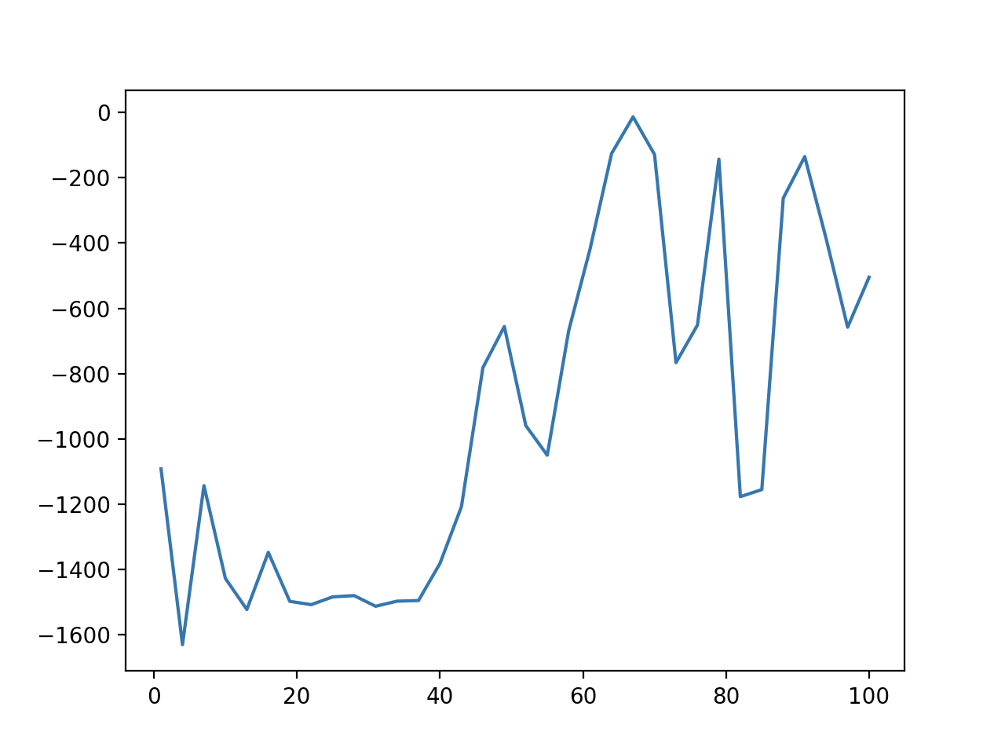
Tau - rate of updating Target Network
Tau = 0.005
Tau = 0.0001
Tau = 0.001
Highest reward values

Slide 31
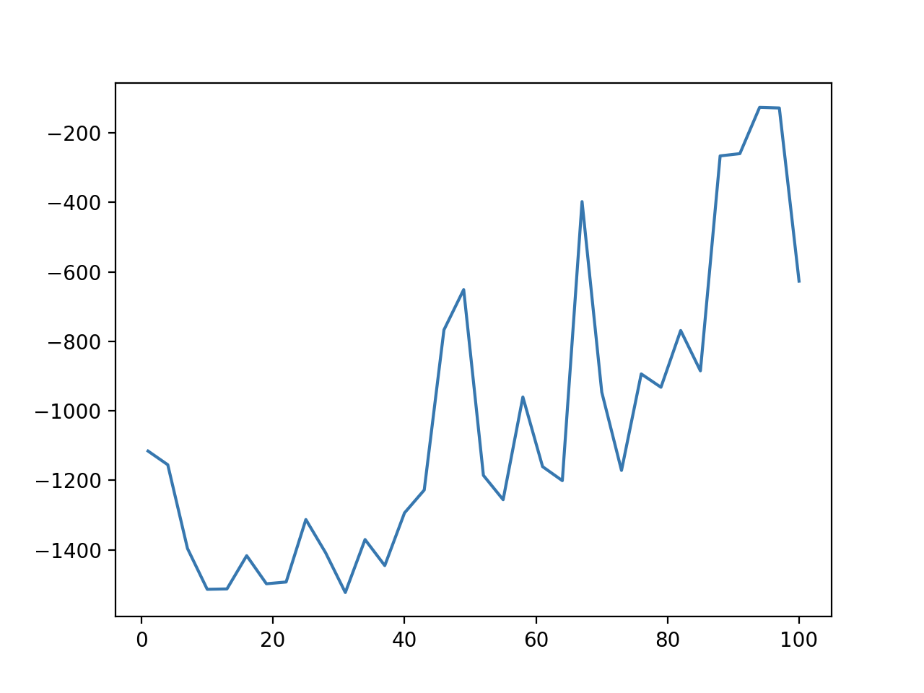
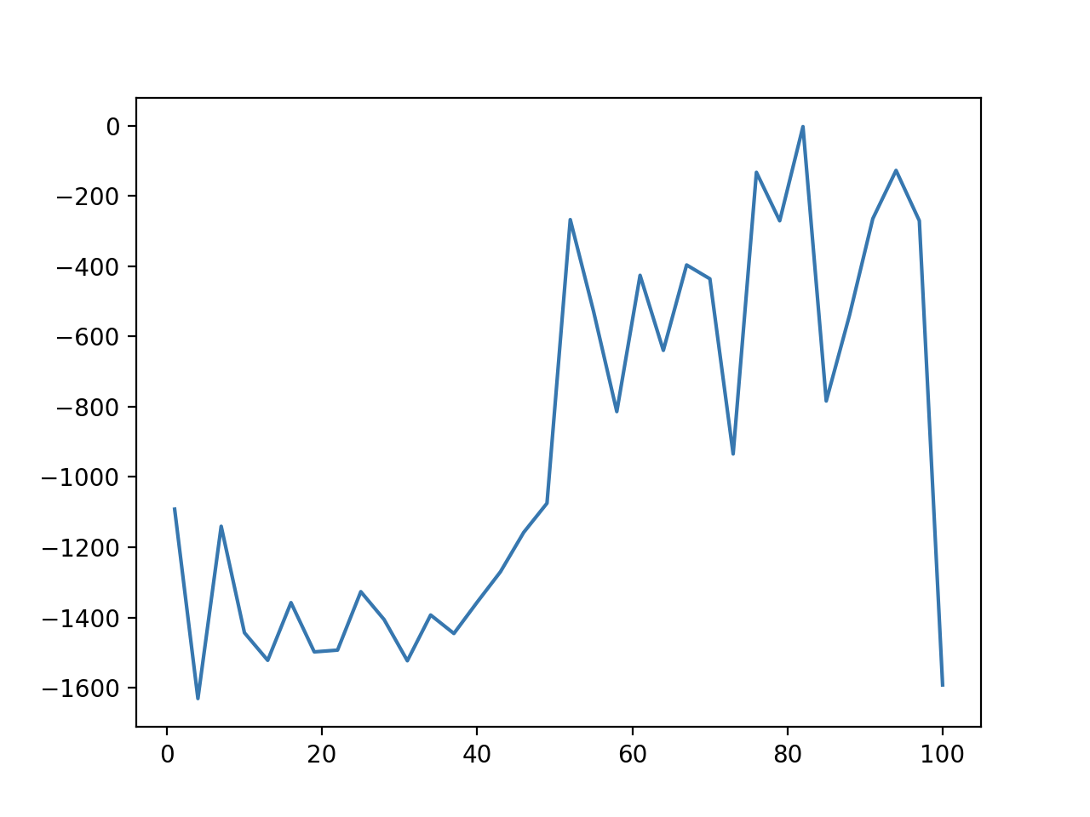
Actor Learning Rate
Rate= 0.0005
Rate = 0.001
Rate = 0.0001
Highest reward values

Slide 32
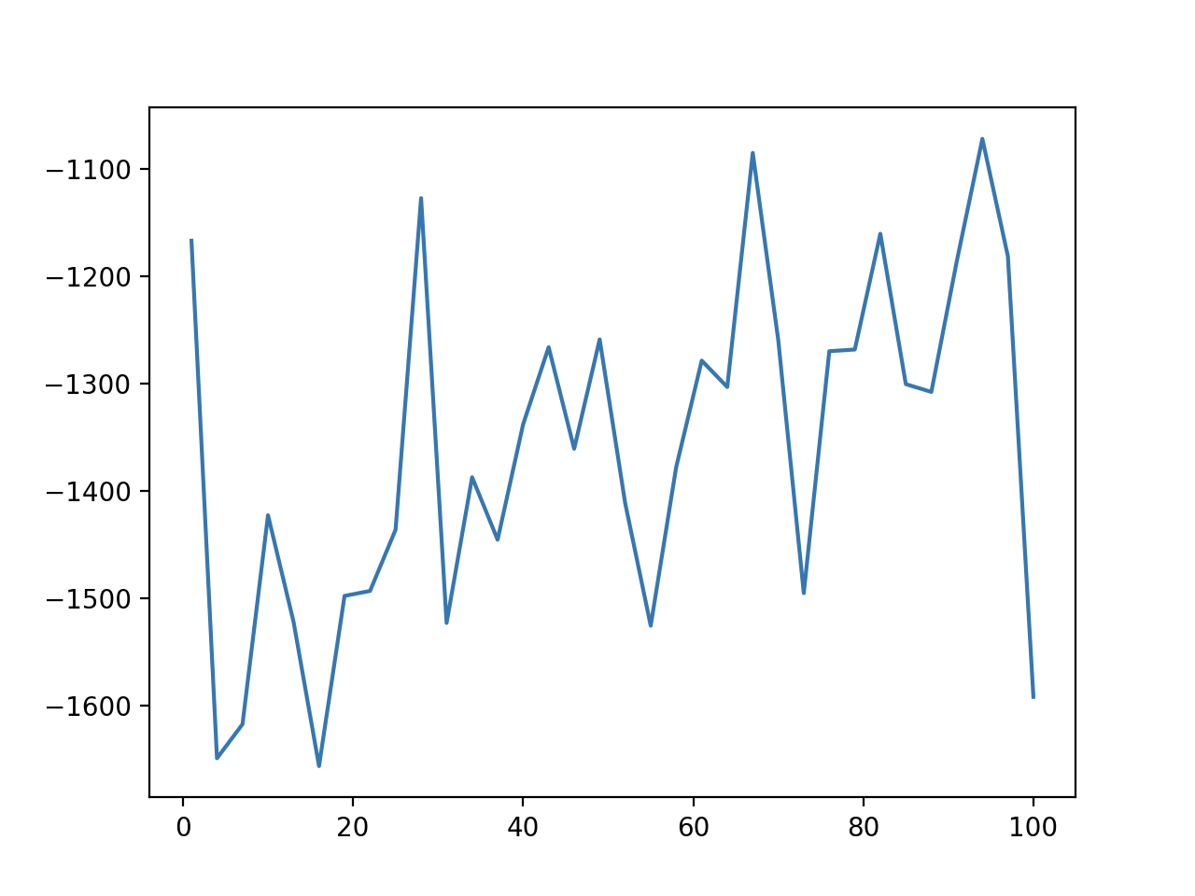
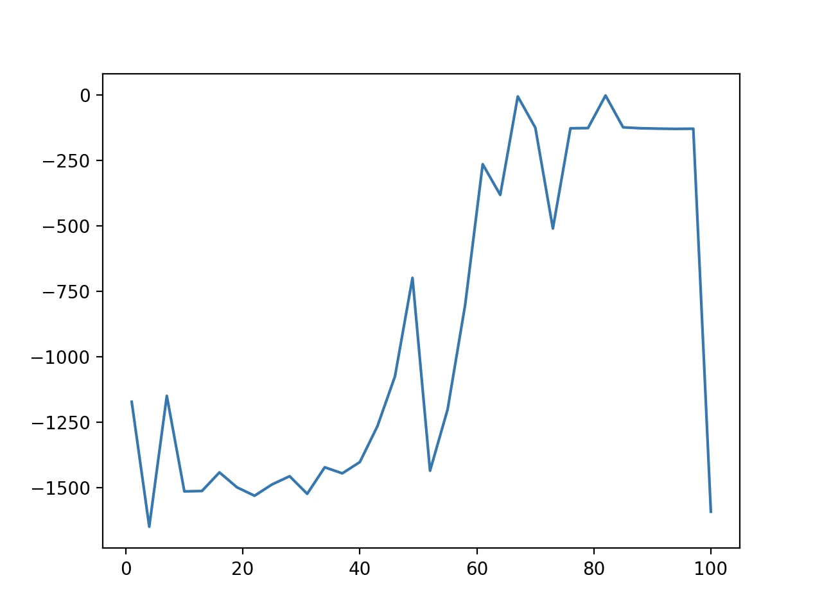
Critic Learning Rate
Rate= 0.0001
Rate = 0.01
Rate = 0.001
Highest reward values

Slide 33
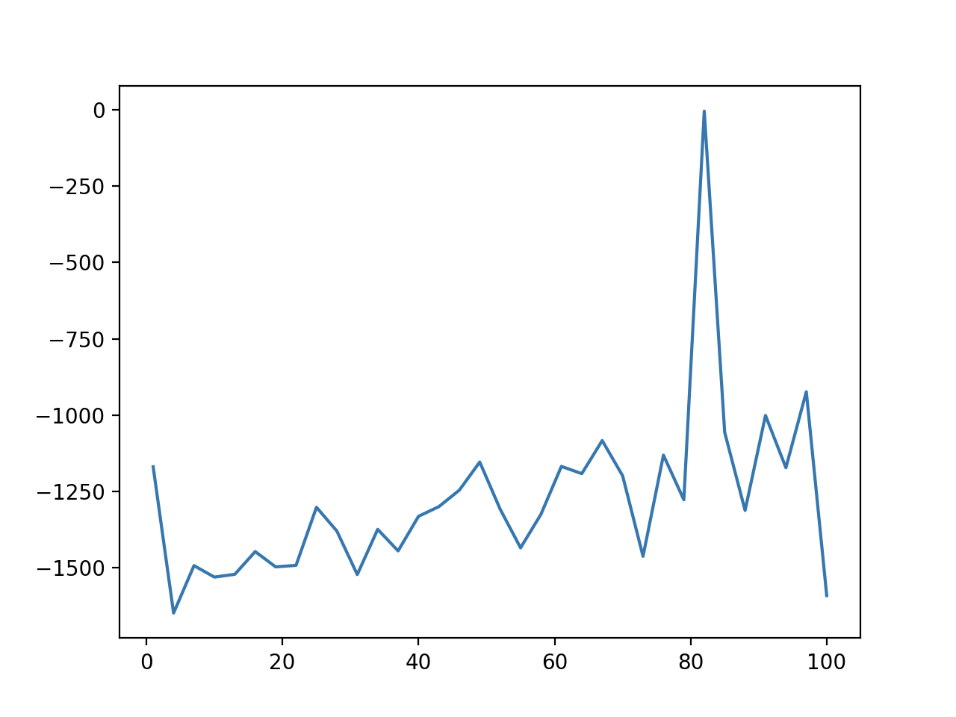
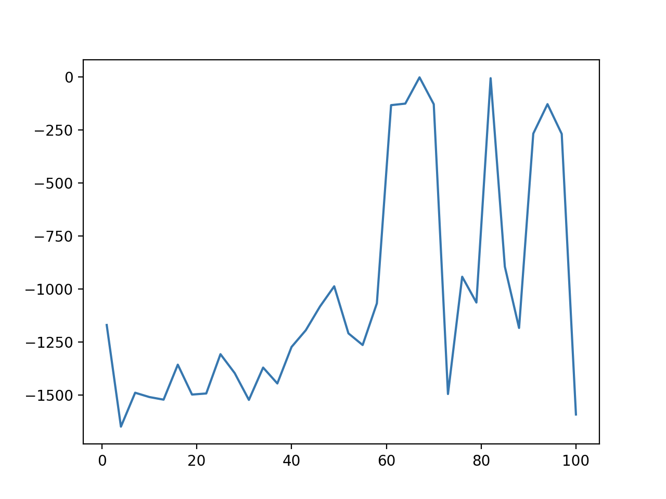
Discount Rate for future Rewards
Rate= 0.8
Rate = 0.95
Rate = 0.99
Highest reward values

Slide 34
The Best Results Observed
Hyperparameters Used for the best results:
No of episodes: 400
Tau Rate = 0.001
Actor Learning Rate = 0.0001
Critic Learning Rate = 0.001
Gamma / Discount Rate: 0.99
Batch Size: 64
Buffer Size: 1000000

Slide 35

Result:

Slide 36
Conclusion
Successfully solved 3 OpenAI Problems using 3 different algorithms
Q-learning, Deep Q Learning, DDPG

Slide 37
Future Directions
Try Reinforcement Learning on Atari Games

